Slide 1




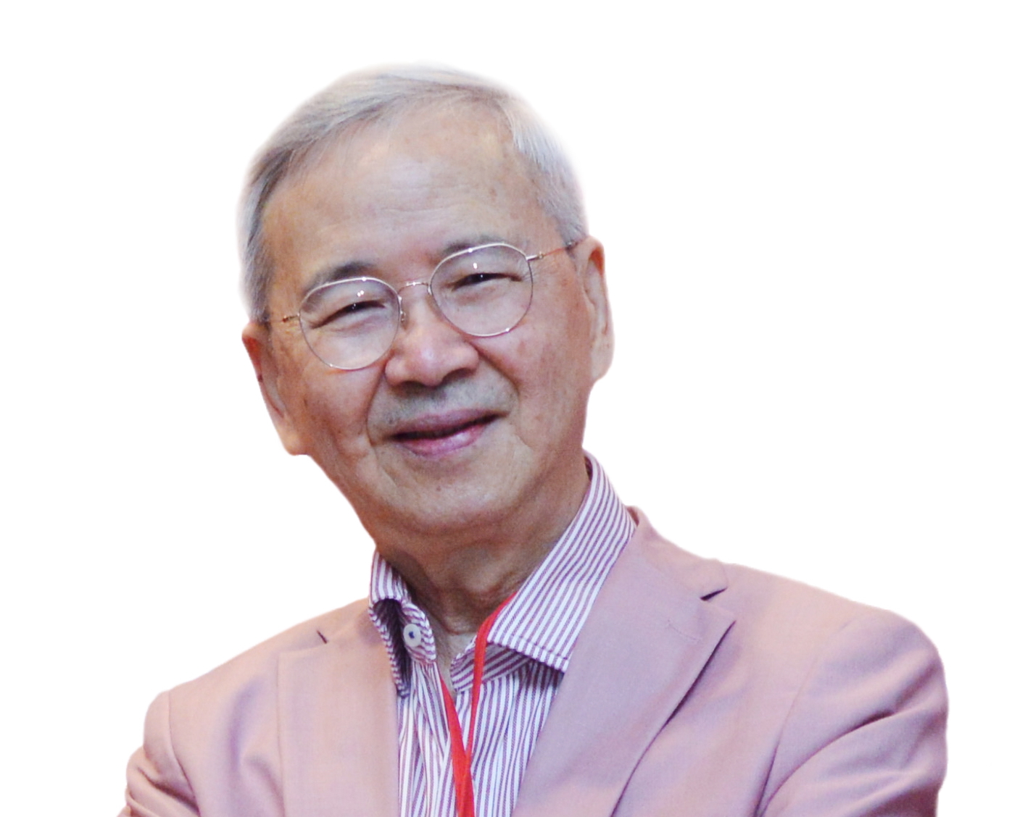
30 January 2026

Slide 2

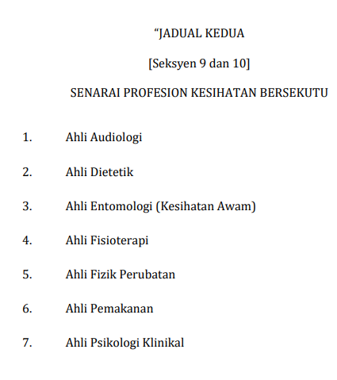
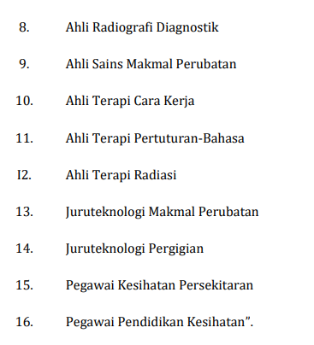
JADUAL KEDUA (PINDAAN 24 MAC 2022)

Slide 3

STANDARD PENDAFTARAN
Kelayakan | Bahagian | Profesion
Ijazah Sarjana | - | Ahli Psikologi Klinikal
Ijazah Sarjana Muda | - | Ahli Audiologi Ahli Dietetik Ahli Entomologi (Kesihatan Awam) Ahli Fizik Perubatan Ahli Pemakanan Ahli Sains Makmal Perubatan Ahli Terapi Pertuturan – Bahasa Pegawai Pendidikan Kesihatan

Slide 4
KELAYAKAN
AHLI PEMAKANAN
KELAYAKAN
Ijazah Sarjana Muda dalam bidang Pemakanan atau setaraf yang diiktiraf oleh Majlis Bachelor’s degree in the field of Nutrition or equivalent as recognised by the Council

Slide 5
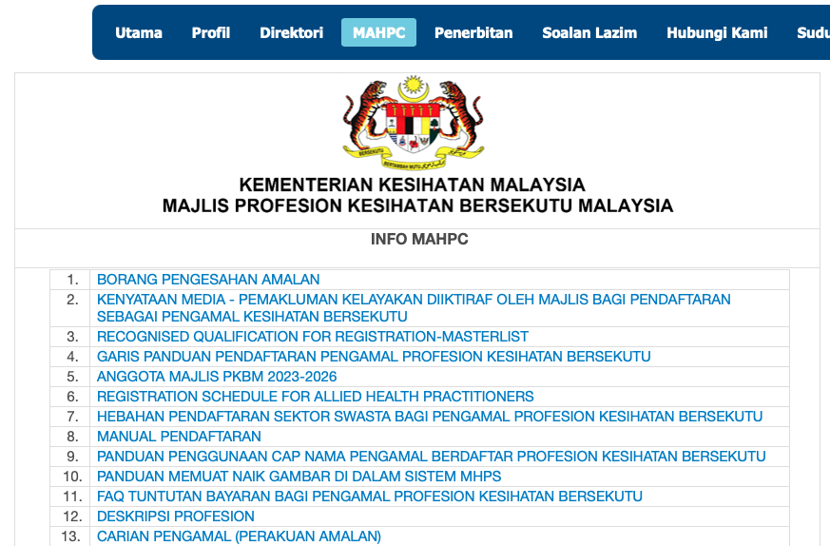
https://hq.moh.gov.my/alliedhealth/index.php/ms/site-mahpc/info-mahpc

Slide 6
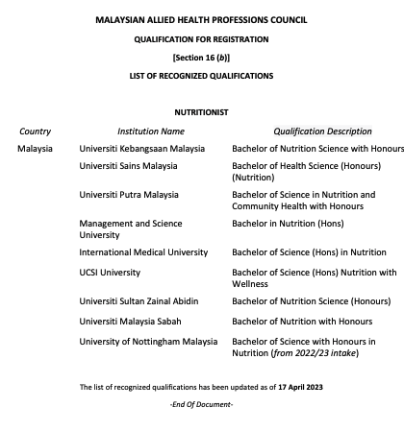

Slide 8
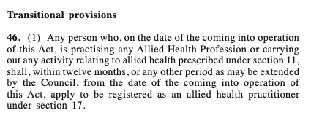
ALTERNATIVE QUALIFICATIONS
Applicant possess other academic qualifications besides those which have been recognised by the Council, but possess certified experience in practising in the relevant allied health professions and possess other relevant trainings in the relevant allied health profession
To enable professionals currently practising in nutrition to be registered

Slide 9
https://hq.moh.gov.my/alliedhealth/index.php/ms/site-mahpc/info-mahpc

Slide 10
Description of AHLI PEMAKANAN /NUTRITIONIST
A Nutritionist advocates and promotes nutritional well-being of the individual and population to prevent and control nutrition-related diseases through policies and regulations, promotion and education, training, assessment and monitoring of nutritional status, nutrition interventions, consultancy, and research and development.

Slide 11
Description of DIETITIAN
A Dietitian assesses, diagnoses and treats dietary problems using medical nutrition therapy. The dietitian translates scientific information on nutrition, health and disease into practical guidance to enable individuals to obtain nutrients, make appropriate life style and food choices to manage disease conditions and promote health; and ensures the provision of safe and nutritious foods.

Slide 12
Nutritionists should play key roles in the national health agenda
  can and should be involved in wide variety of programmes and activities
  in the promotion of nutritional wellbeing of the population in various ways
    as well as to prevent and control nutrition-related diseases of various identified target groups
Nutritionists can be involved in various settings –
  community, academia, research organisations, corporate sector, professional bodies ….
in one or more of the following scopes of practice
  to contribute to the national health agenda
12

Slide 13
SCOPES OF PRACTICE OF NUTRITIONISTS
1. Advocate and promote nutritional well-being of individual, communities and population groups.
2. Prevent and control nutrition related diseases of various groups at different settings and levels.
3. Assess, monitor and evaluate nutritional status of individual, communities and population groups
4. Provide input for the development and implementation of nutrition and related policies and action plans.
6. Develop, implement and evaluate nutrition intervention programmes.
5. Undertake and support nutrition research and communicate findings at various levels.
7. Undertake capacity building in nutrition through education and training.

Slide 14
SCOPES OF PRACTICE OF NUTRITIONISTS
8. Coordinate and carry out multi-sectoral nutrition activities / programmes
9. Provide guidance on nutritional aspects for the formulation and development of products and services.
10. Provide technical advice for the development and implementation on nutritional aspects of food regulations and guidelines.
11. Provide technical advice and consultations in nutrition and nutrition-related matters.
12. Provide input on product quality and safety from nutrition perspectives
13. Provide nutrition communication materials complying with the prevailing regulations and guidelines.

Slide 15
https://hq.moh.gov.my/alliedhealth/index.php/ms/site-mahpc/info-mahpc

Slide 16
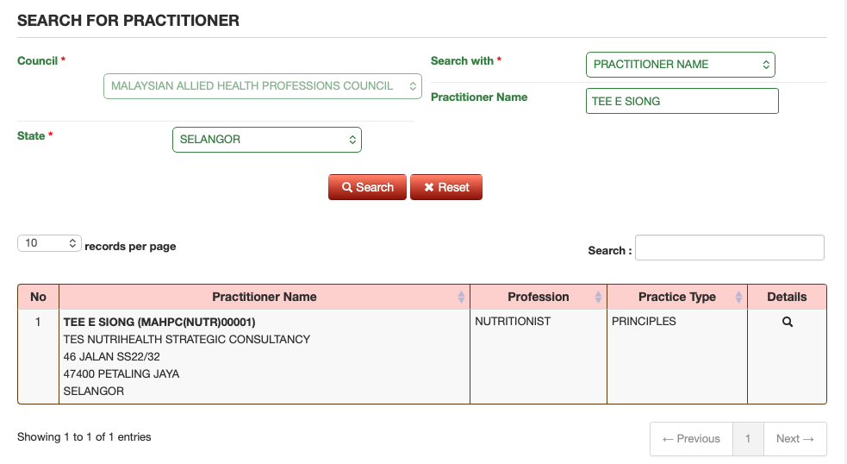
SCOPES OF PRACTICE OF NUTRITIONISTS

Slide 17
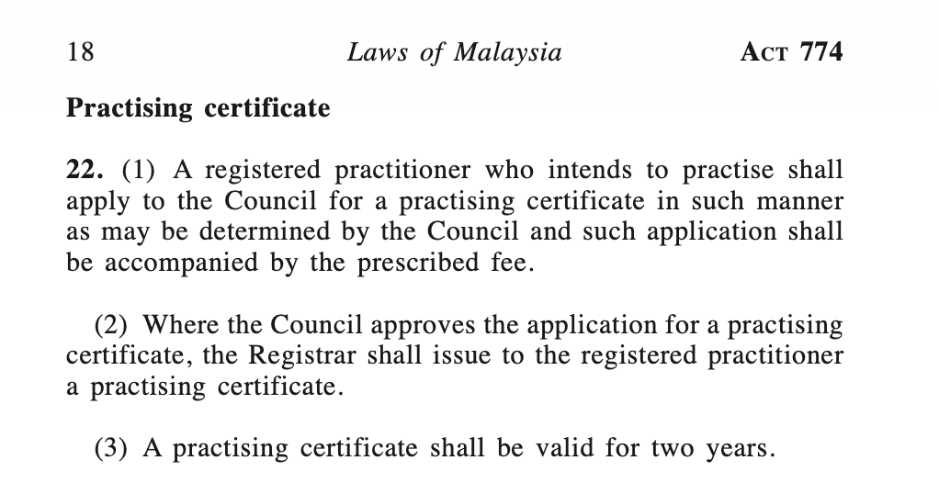
SCOPES OF PRACTICE OF NUTRITIONISTS

Slide 18
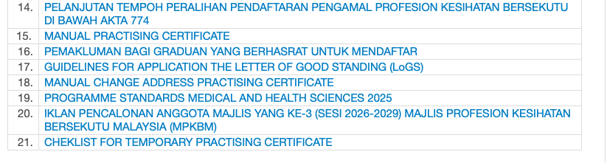
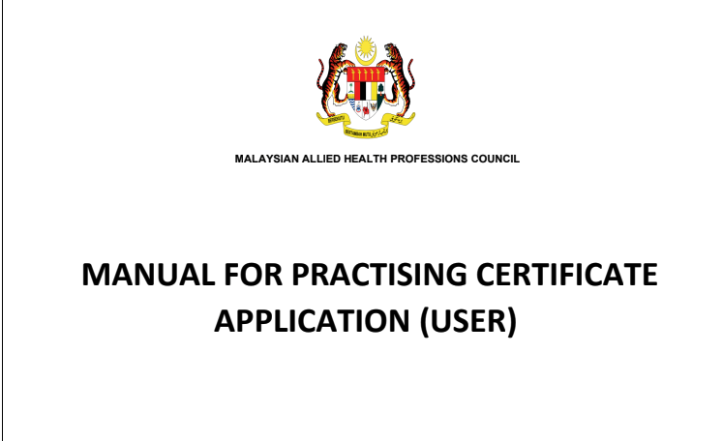
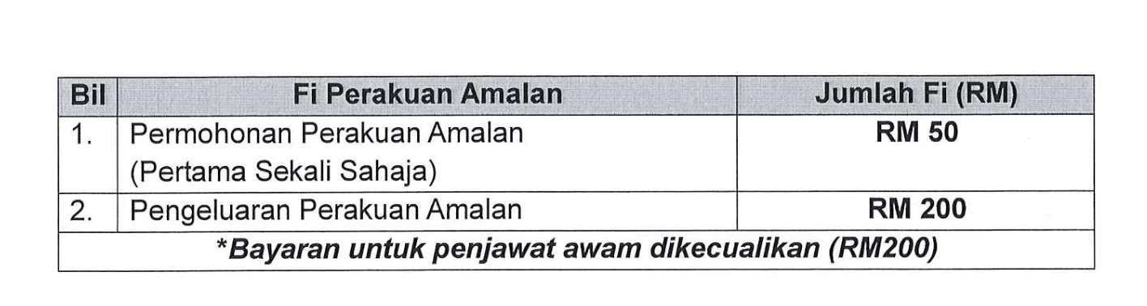
SCOPES OF PRACTICE OF NUTRITIONISTS

Slide 19
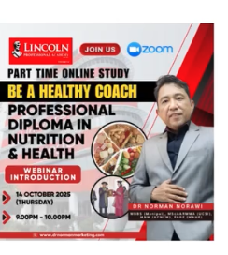
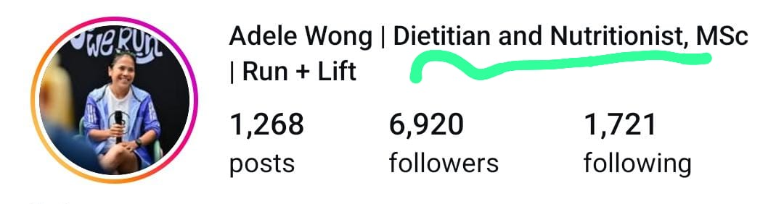
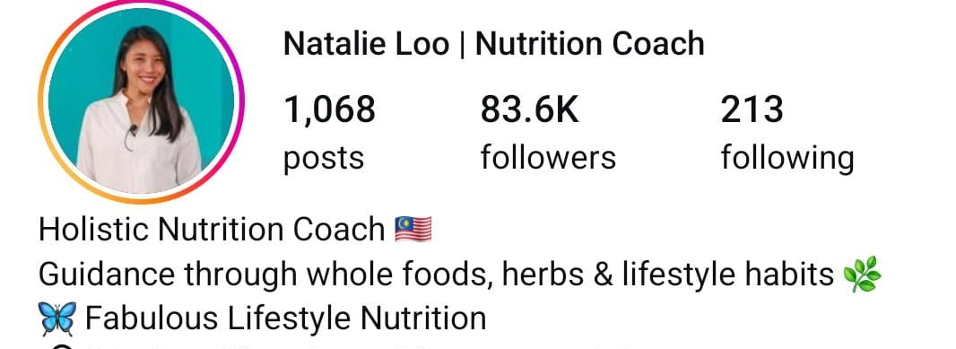
SCOPES OF PRACTICE OF NUTRITIONISTS
Practices, non recognized courses, etc

Slide 20
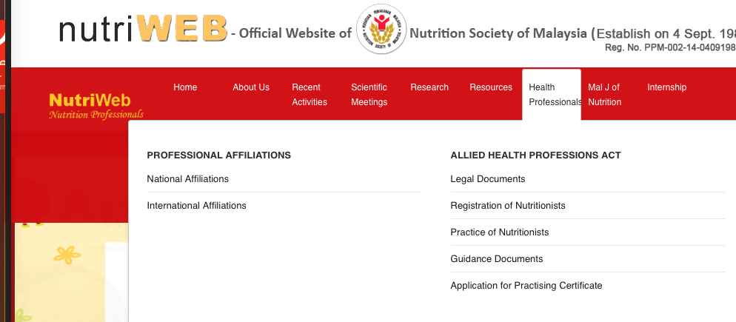
https://nutriweb.org.my/index.php?guidance-documents

Slide 21
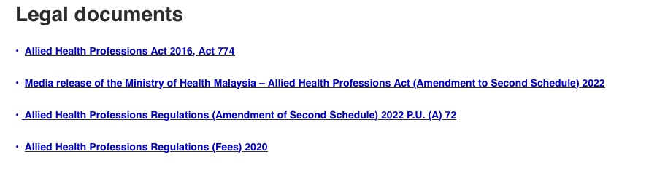
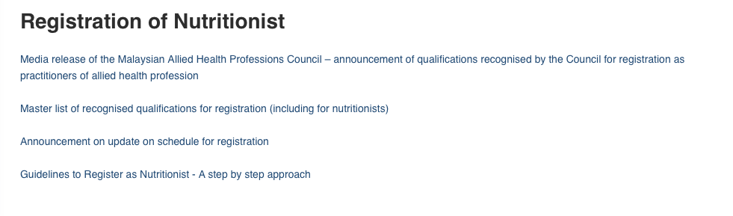

Slide 22
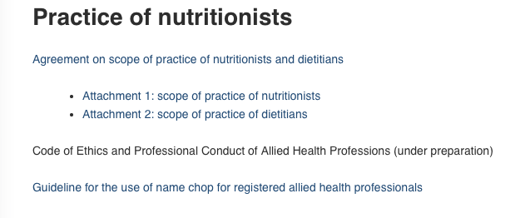
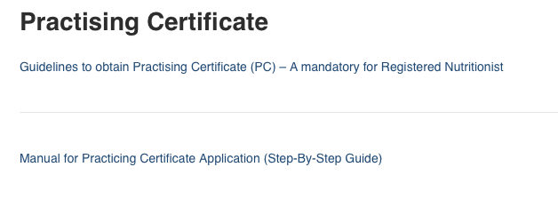

Slide 23
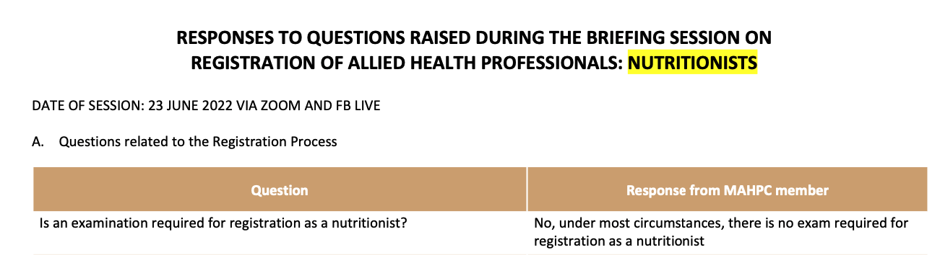
List of commonly asked questions and answers in NSM website:
https://nutriweb.org.my/pdf/RESPONSES%20TO%20QUESTIONS%20DURING%20BRIEFING%20SESSION%20FOR%20AHP-%20NUTRITIONISTS_final%20for%20web.pdf

